Slide 1
York Code Dojo “Ray Tracing”
Chris Maughan
mornymorny@gmail.com
Coder @ NVIDIA

Slide 2

Cars

Slide 3

Glass / Reflections

Slide 4
Realistic Lighting
Many approaches, under the loose term ‘Global Illumination’
Radiosity – simulates diffuse ‘lambertian’ surface interactions
Photon mapping – simulates soft lighting effects
Ray tracing – good for reflections, glass, etc.
Path tracing – very realistic, good for modelling material properties
Spherical Harmonics – good for real time
G-Buffer – common in games

Slide 5
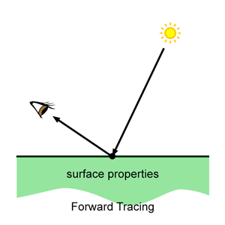
How does light work in the real world?
Gross simplification
Light seen based on
Light source size/intensity/color
Atmospheric effects
Surface properties
Other light sources
Iris / eye mechanics
Perception

Slide 6
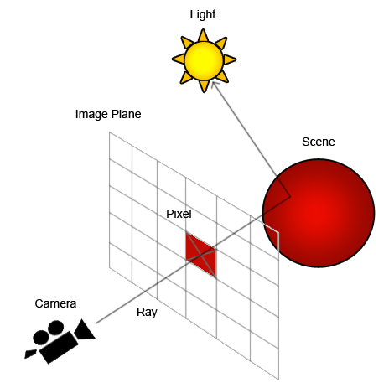
What is a Ray Tracer?
A simple method of lighting a 3D scene by evaluating the light arriving at each pixel on the screen
A recursive algorithm that traces rays from the eye, bouncing them off surfaces in the ‘world’
Works ‘in reverse’ to the real world

Slide 7
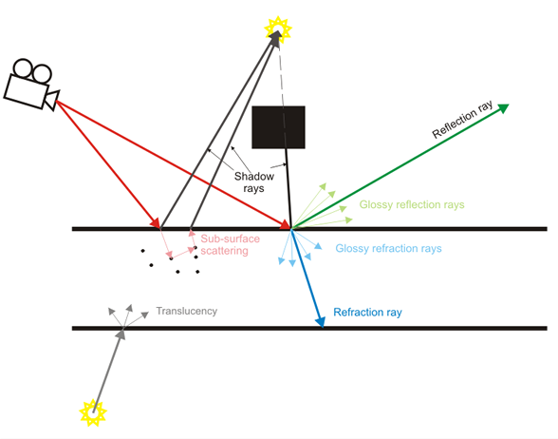
… it can get more complicated!

Slide 8
Basic Math & Code Overview
Dot Product: glm.dot(v1, v2). From 0->1 from 90-0 degrees
Reflect: glm.reflect(Incident, normal). Reflect a ray about a normal
From origin/ray to a point: origin + (ray * distance)
Mostly, you’ll want to normalize rays: glm.normalise(v1)
Intersection is in the object class, just call it and it will return a distance
The object class will also return a normal for a given point and a material value
for (auto& object : sceneObjects)….
foreach (var object in sceneObjects)….
The sample generates camera rays for you

Slide 9
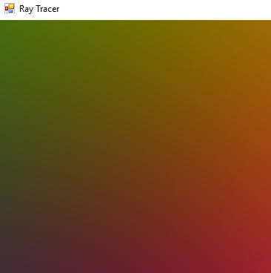
Starter Kit in C++ & C#
Scene is setup
Camera rays are generated for you
Empty ‘TraceRay’ function
Default implementation just turns camera rays into colors
Color = (ray.x,ray.y, ray.z) * .5 + 1.0f

Slide 10
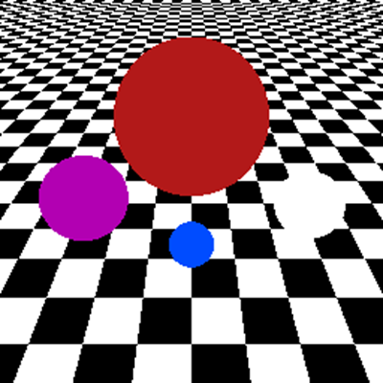
Step 1 Ray-Object Intersection
Test each camera ray against every item in the scene (TraceRay(…))
If the ray intersects, find the point of intersection
Ask the object for the material at that point
Return the albedo (base color) from the material
Scene Object
Cam Ray

Slide 11
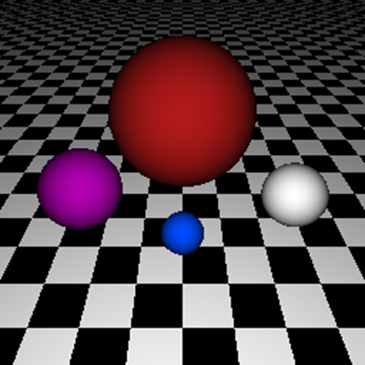
Step 2 Simple Diffuse Lighting
At the ray intersection point, get the normal to the surface
Calculate the lighting intensity using a dot-product of the normal and a light ray (try 0, 0, -1 or ‘rayDir’ for the light, as shown here).
Multiply the albedo material color by the light intensity
Normal
Light

Slide 12
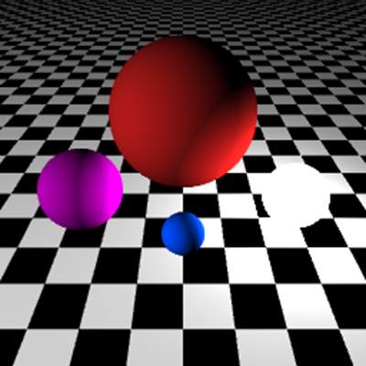
Step 3 Point light sources
Walk all objects in the scene and find out if any have emissive color (they are lights)
Calculate a normalized direction to the object from the intersection point
Do the same diffuse lighting calculation
Camera Ray
To Light Ray
Light

Slide 13
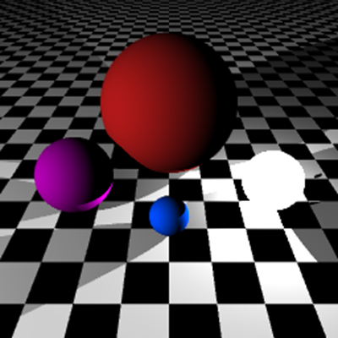
Step 4 Occluders
While calculating rays to emitters, walk the objects in the scene and check for ‘occluders’. i.e. objects in the way of the light
Ignore emitters that are obscured from the point of view of the intersection point
Camera Ray
To Light Ray
Scene Object (Occluder)
Light

Slide 14

Step 5 Specular Highlights
When doing the lighting calculation, calculate specular intensity too
Specular intensity is the dot product of the ‘reflection’ vector about the ray normal, with the light ray.
Raise the specular intensity by a power, and multiply by specular material color
Cam Ray
Normal
Light
Reflect Ray

Slide 15
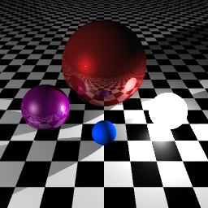
Step 6 Reflections
When intersecting the first object, check the returned material, and if it is reflective….
Get the surface normal and use it to generate a reflection ray based on the arriving ray
Call your TraceRay function with the new ray and add the returned color to the output result
Recurse into TraceRay up to MaxDepth (start with 2 or 3)

Slide 16
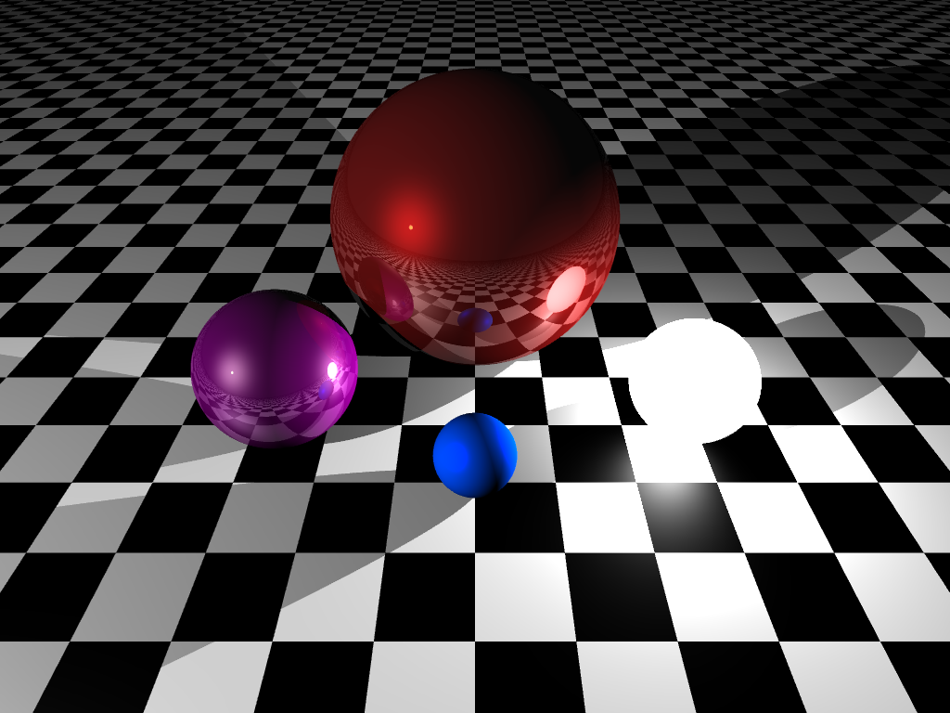
Target…
Shadows
Reflections
Point lights
Specular highlights
(additionally – antialiasing)

Slide 17
Resources
http://www.pbrt.org/
Awesome book and open source code
http://www.scratchapixel.com

Slide 18
Thanks
Doug/Isotoma for the Pizza, Drinks and Venue

Slide 19
Meetups!
York Game Developers, 3rd Thursday, The Crown, York
http://www.meetup.com/York-Game-Developers/
York Code & Coffee – Wednesday 7AM+, Perky Peacock Lendal
http://www.meetup.com/York-Code-Coffee/
Leeds Code Dojo
http://www.meetup.com/Leeds-Code-Dojo/

Slide 20
Slack – York Developer Community
Mail me, David or Daniel to get on the group
yorkdevelopers.slack.com
For coders in the York area
Channels for #gamedev, #codeandcoffee, #yorkcodedojo,#development,….

Slide 21
Questions ?

